Slide 1

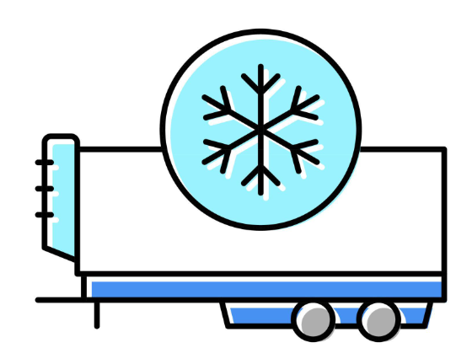
Cold chain solution
- Changing the wiring for connection to the thermograph
- Physical connection of Vetronics equipment and thermograph cabling
Configuration of the thermograph communication port
Diagnosis of telematics units after installation

Slide 2
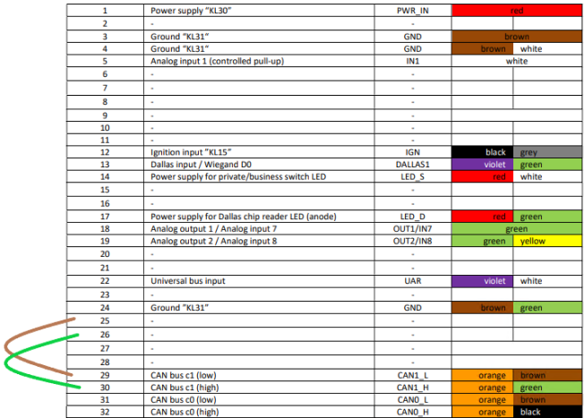
- Changing the Vetronics wiring for connection to the thermograph

Slide 3
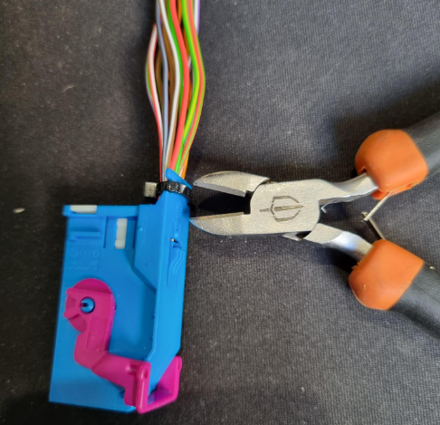
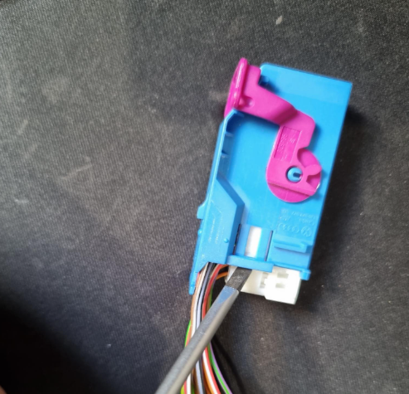
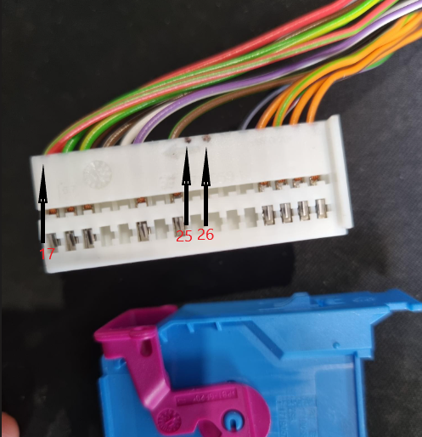
Modification of the wiring in the Vetronics device for connection to the thermograph:
-cut the fixing strip: -force locking : -identify pins 25 and 26:

Slide 4
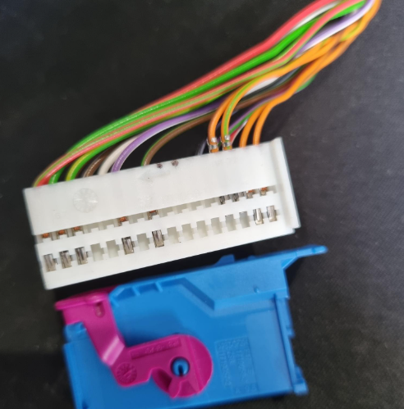
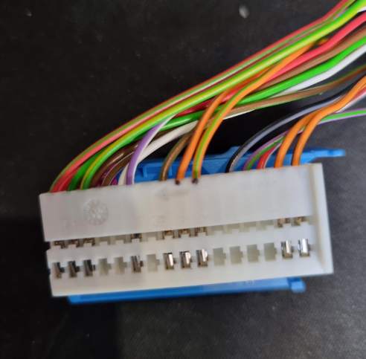
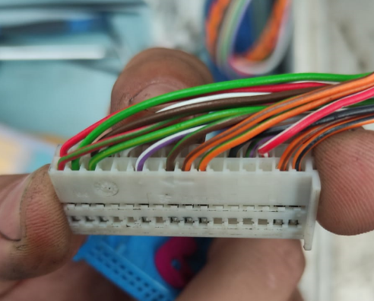
Modification of the wiring in the Vetronics device for connection to the thermograph:
-remove the orange/green and -insert the orange/brown and into pins 25 and 26
orange/brown handles : orange/green cables :
please note:
Orange/brown = pin 25
Orange/green = pin 26

Slide 5
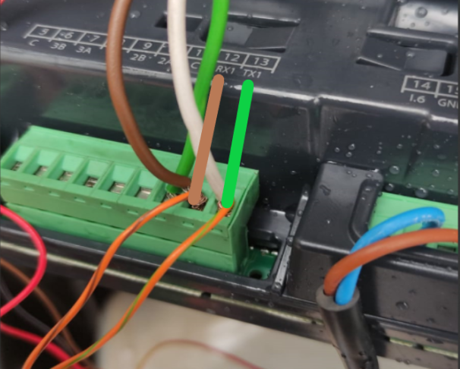
Physical connection of Vetronics equipment and thermograph cabling :
The orange and brown wires (RSO2) shall be connected to the COM RX terminal of the thermograph.
The orange and green wires (RSI2) shall be connected to the COM TX terminal of the thermograph.

Slide 6
Configuration of the thermograph communication port:
With many thermographs on the market, it is necessary to activate their communication ports in order to obtain temperature data from the Vetronics device.
thermographs with possible temperature reading:
Datacold 300
Datacold 500
Datacold 600
Euroscan X2
Touch Print

Slide 7
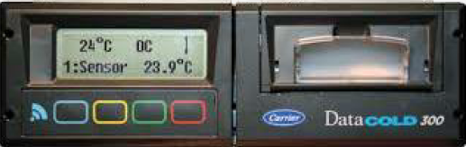
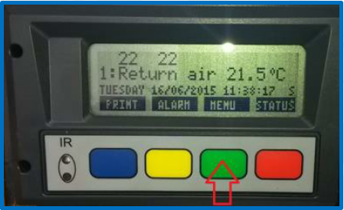
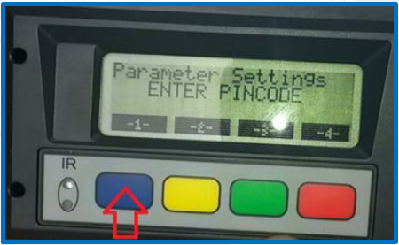
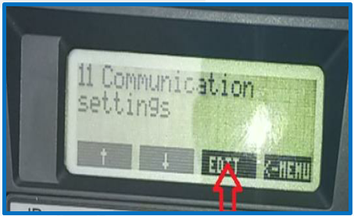
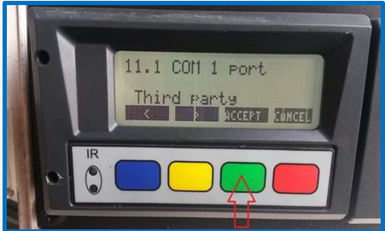
Datacold 300
press green to
accept the configuration
click on green
Insert PIN : 1111
press green to edit
Please note:
The third-party protocol must be selected for the connected COM port!

Slide 8
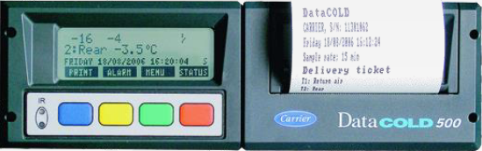

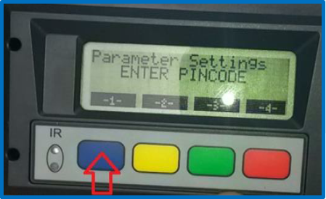
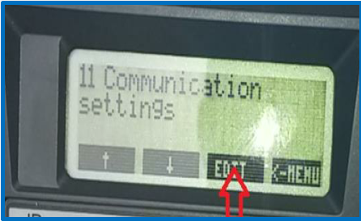
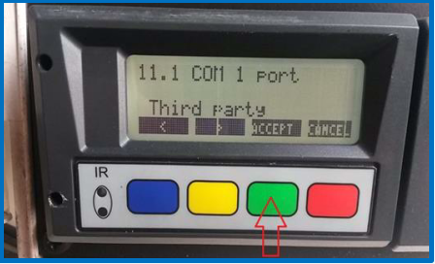
Datacold 500
press green to
accept the configuration
click on green
press green to edit
Insert PIN : 1111
Please note:
The third-party protocol must be selected for the connected COM port!

Slide 9
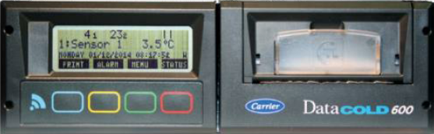
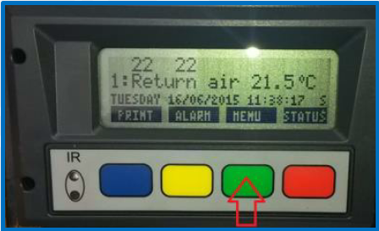
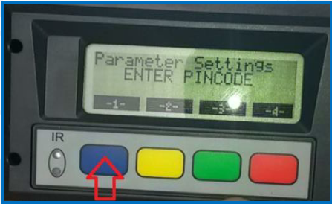
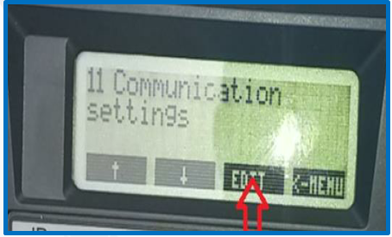
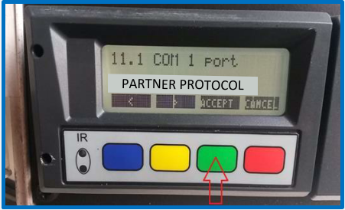
Datacold 600
press green to
accept the configuration
Insert PIN : 1111
click on green
press green to edit
Please note:
The third-party protocol must be selected for the connected COM port!

Slide 10
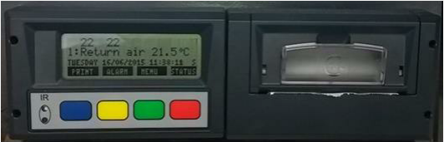
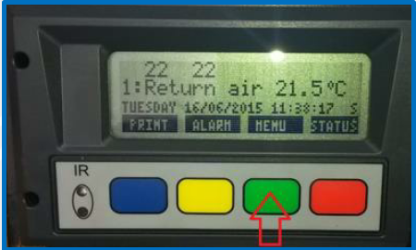
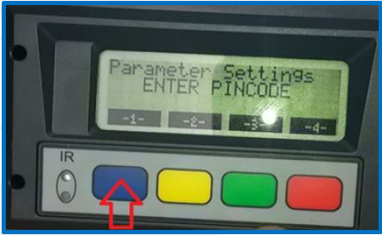

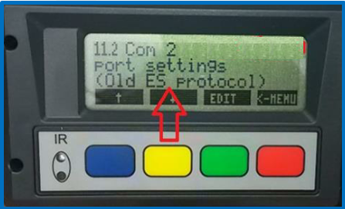
EUROSCAN X2
press green to
accept the configuration
click on green
Insert PIN : 1111
press green to edit
Please note:
The third-party protocol must be selected for the connected COM port!

Slide 11
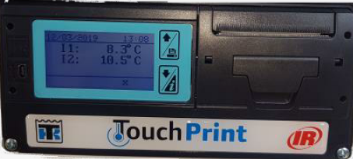
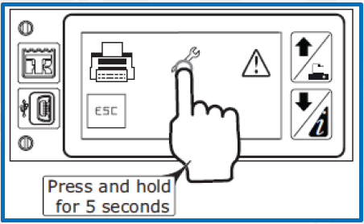
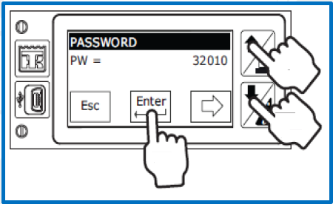
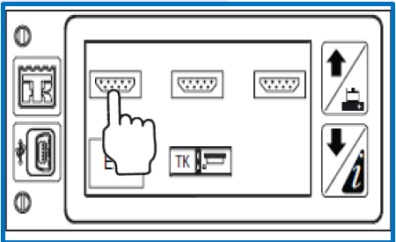
Thermo King / Touch Print
press and hold the tool symbol
for 5 seconds
enter pin : 32010 and
press enter
select the first communication port
Please note:
The MODBUS protocol must be selected for the connected COM port!

Slide 12
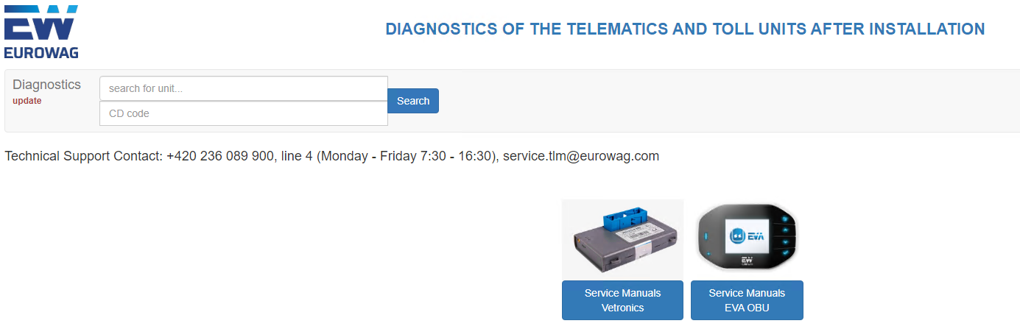
Diagnosis of the telematics units after installation:
Access the diagnostics page to perform the connectivity test and check the thermograph temperatures :
Diagnostics (princip.cz)

Slide 13
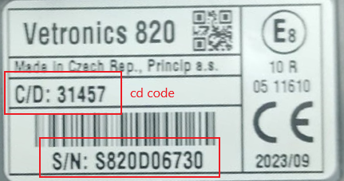

Enter the unit's serial number and CD code
to access the diagnostic tests :
Press search :

Slide 14
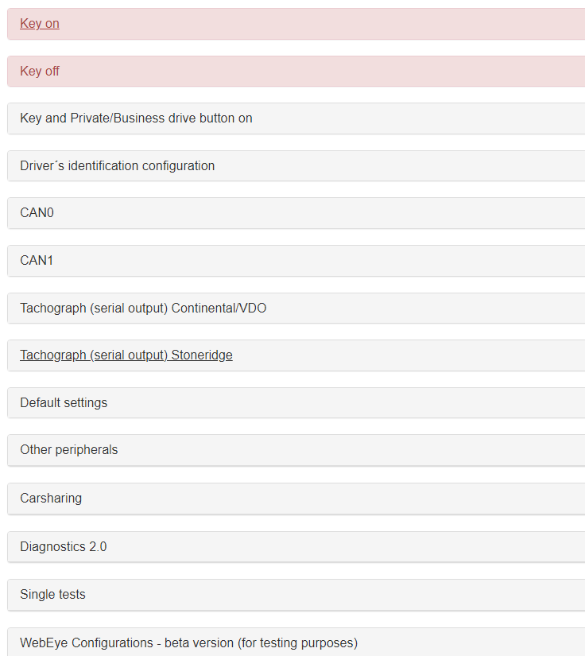
After clicking Search, a table of tests
will appear, select ‘other peripherals’.

Slide 15
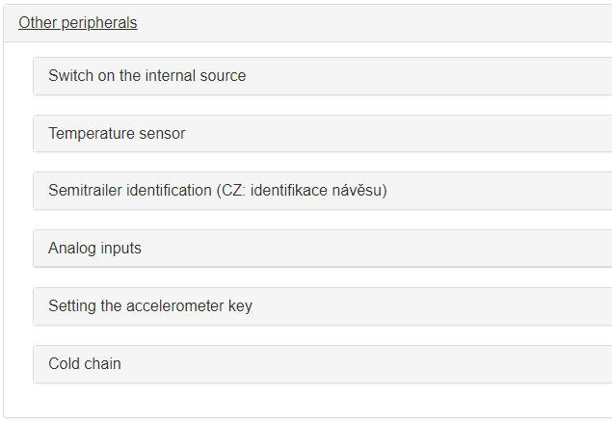
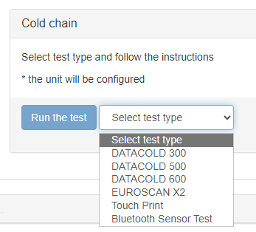
After selecting other peripherals,
select cold chain
Select the type of tremograph and then ‘run the test’.

Slide 16
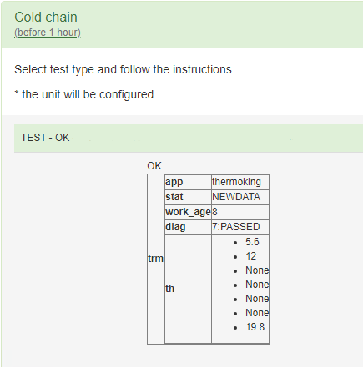
The successful test should appear as :

Slide 17
If you have any doubts or questions, please contact me via my email address, paulo.cerqueira@eurowag.com, or via my mobile contact (with access to whatsapp) +351 913 362 290.
Thank you for your attention

